Slide 1


Varun Vaidya
22nd December, 2023

Slide 2

Outline
Executive Summary
Introduction
Methodology
Results
Conclusion

Slide 3
Executive Summary
Methodologies Summary:
The project employed a comprehensive set of methodologies, including data collection through SpaceX RESTful API calls and web scraping, data wrangling, exploratory data analysis (EDA) using visualization and SQL queries, interactive visual analytics with Plotly Dash, and predictive analysis using classification models.
Results Summary:
The predictive models, including Support Vector Machines (SVM), Classification Trees, and Logistic Regression, demonstrated promising results in determining the success of Falcon 9 first-stage landings.

Slide 4
Introduction
Project Background and Context:
The Falcon 9 first-stage landing prediction project aims to leverage data science techniques to estimate the success of landings, providing valuable insights for cost estimation and competitive bidding in the space launch industry.
Problems to Address:
The primary objective is to predict the success of Falcon 9 first-stage landings, considering the cost implications and competitive advantages of SpaceX in reusing the first stage.

Slide 5

Section 1

Slide 6
Methodology
Executive Summary
Data collection methodology:
Data collection involved RESTful API calls and web scraping, followed by data wrangling techniques to clean and organize the dataset.
Perform exploratory data analysis (EDA) using visualization and SQL
Perform interactive visual analytics using Folium and Plotly Dash
Perform predictive analysis using classification models
How to build, tune, evaluate classification models

Slide 7
Data Collection
Collecting the Data with SpaceX REST API
Convert JSON to a pandas dataframe
Perform a get request using the requests library to obtain the launch data with .json() method
Python BeautifulSoup package to web scrape some HTML tables from wikipedia

Slide 8
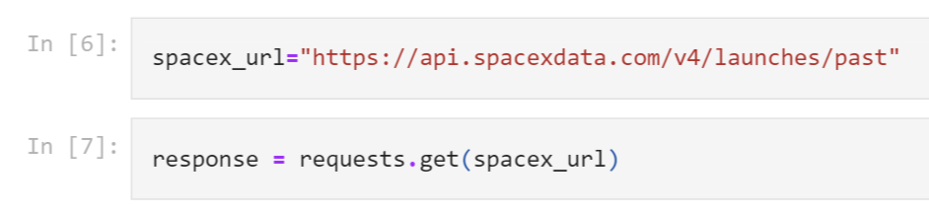
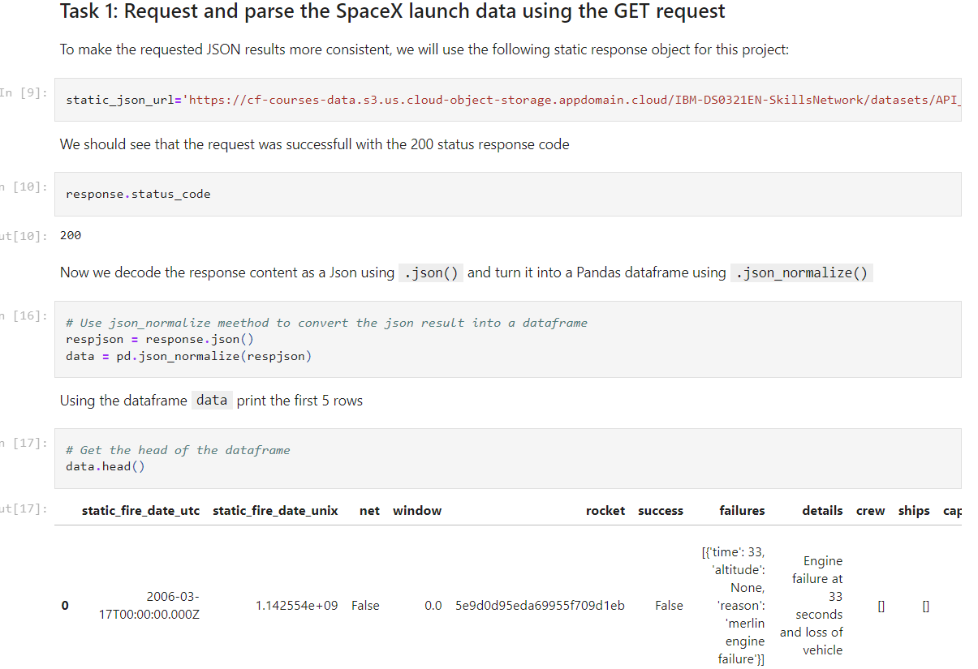
Data Collection – SpaceX API
GitHub Link:-
https://github.com/bluniv/Falcon9/blob/main/1.%20SpaceX%20Data%20Collection%20API.ipynb

Slide 9
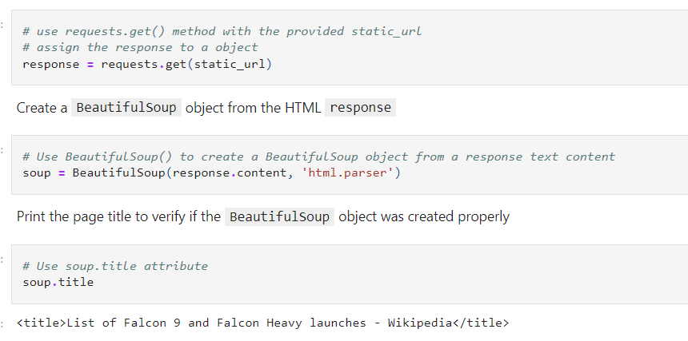
Data Collection - Scraping
GitHub Link :-
https://github.com/bluniv/Falcon9/blob/main/2.%20WebScrapping%20Falcon9%20launches%20records%20from%20Wikipedia.ipynb

Slide 10
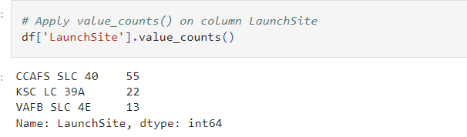
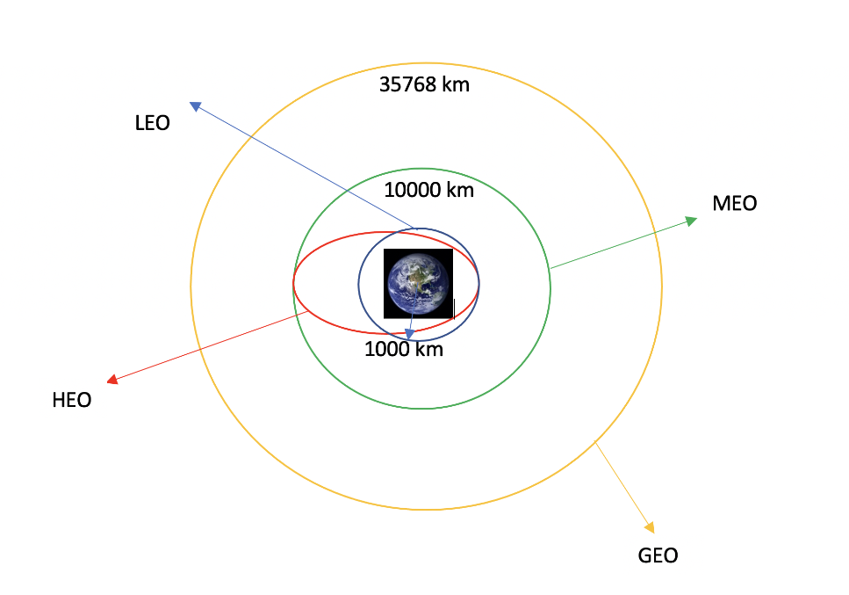
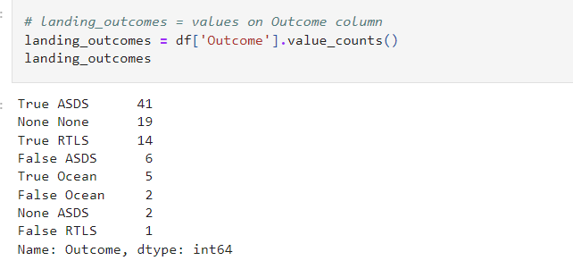
Data Wrangling
GitHub Link:- https://github.com/bluniv/Falcon9/blob/main/3.%20SpaceX%20Data%20Wrangling.ipynb

Slide 11
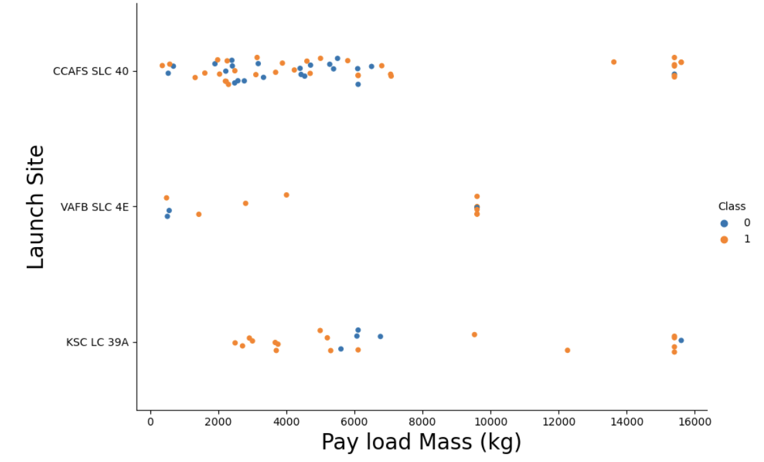
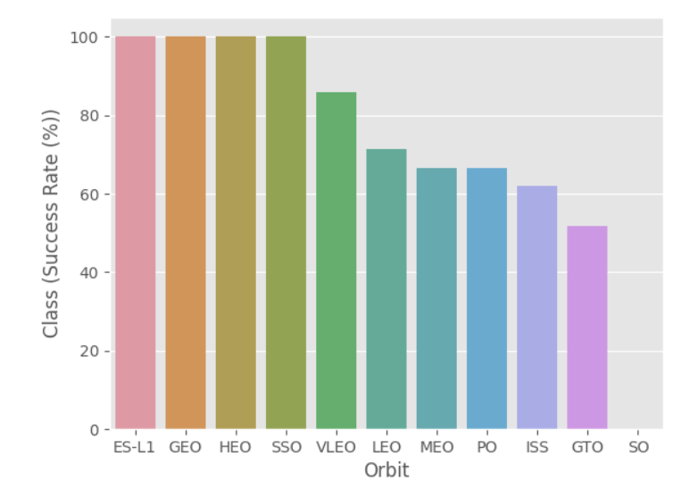
EDA with Data Visualization
GitHub Link:-
https://github.com/bluniv/Falcon9/blob/main/5.%20SpaceX%20EDA%20DataViz%20using%20Pandas%20and%20Matplotlib.ipynb

Slide 12
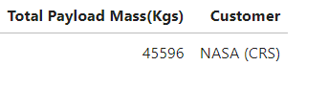
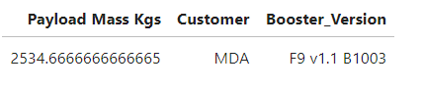
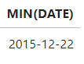
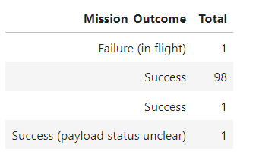
EDA with SQL
GitHub Link:- https://github.com/bluniv/Falcon9/blob/main/4.%20SpaceX%20EDA%20using%20SQL.ipynb
Insights generated :-
Displayed the total payload mass carried by boosters launched by NASA (CRS)
Displayed average payload mass carried by booster version F9 v1.1
Listed the date when the first successful landing outcome in ground pad was achieved.
List the total number of successful and failure mission outcomes

Slide 13
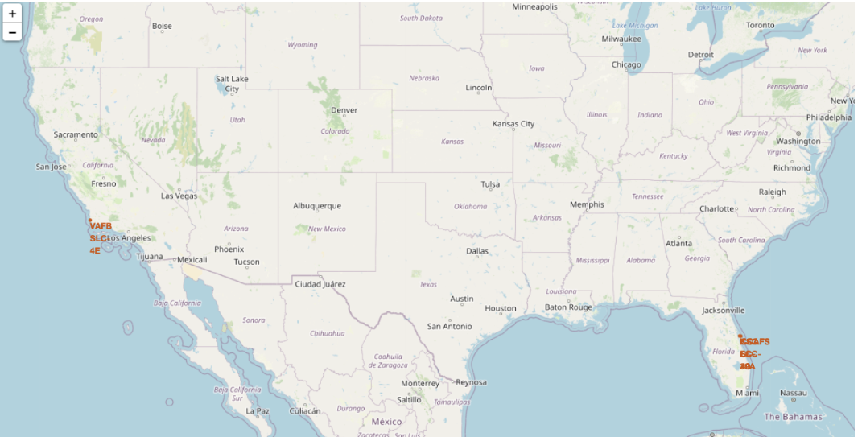
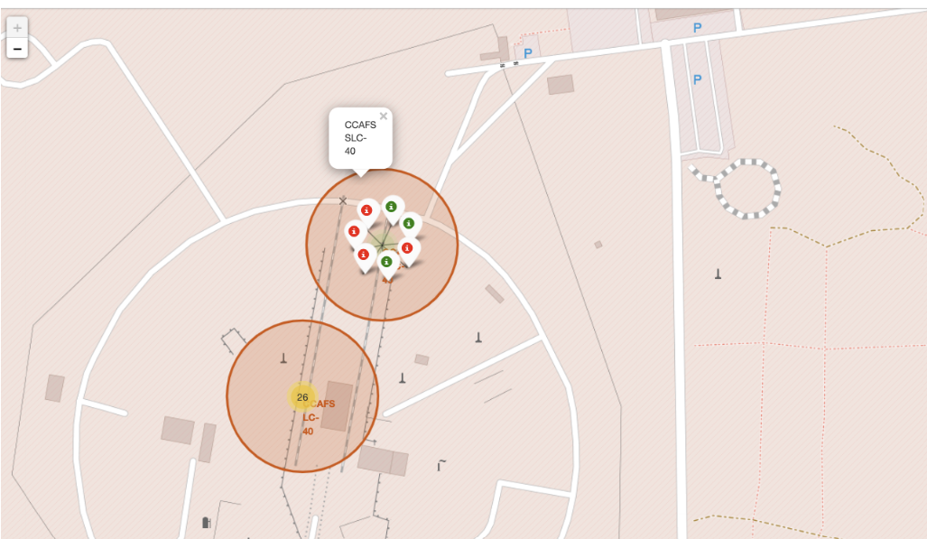
Build an Interactive Map with Folium
GitHub Link:
https://github.com/bluniv/Falcon9/blob/main/6.%20SpaceX%20launch%20sites%20location%20analysis%20with%20FOLIUM%20.ipynb

Slide 14
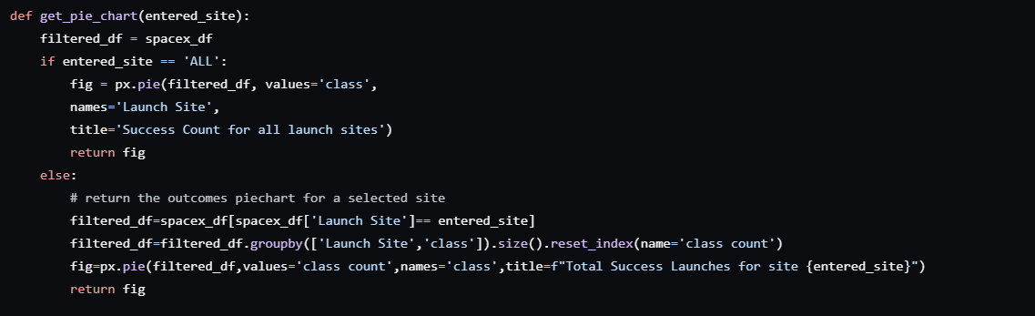
Build a Dashboard with Plotly Dash
GitHub Link:- https://github.com/bluniv/Falcon9/blob/main/7.%20Interactive%20Dashboard%20with%20Plotly%20Dash.py

Slide 15
Predictive Analysis (Classification)
GitHub Link:-https://github.com/bluniv/Falcon9/blob/main/8.%20SpaceX%20Machine%20Learning%20Prediction.ipynb

Slide 16

Section 2

Slide 17
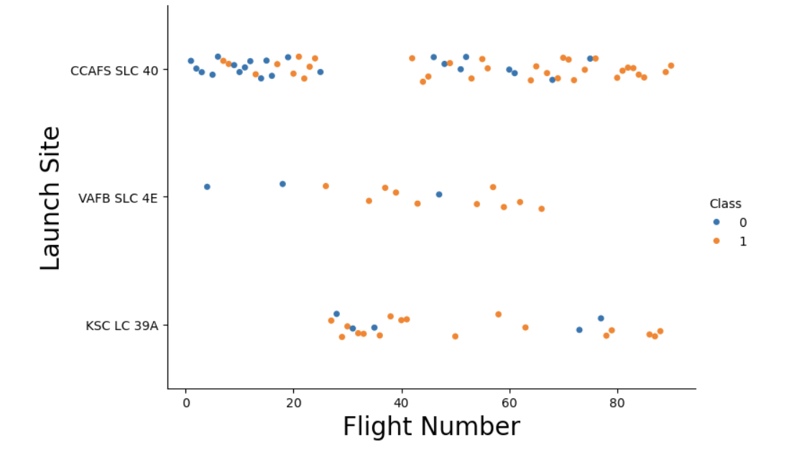
Flight Number vs. Launch Site
VAFB and KSC have a success rate of 77% whereas CCAFS has only 60%

Slide 18
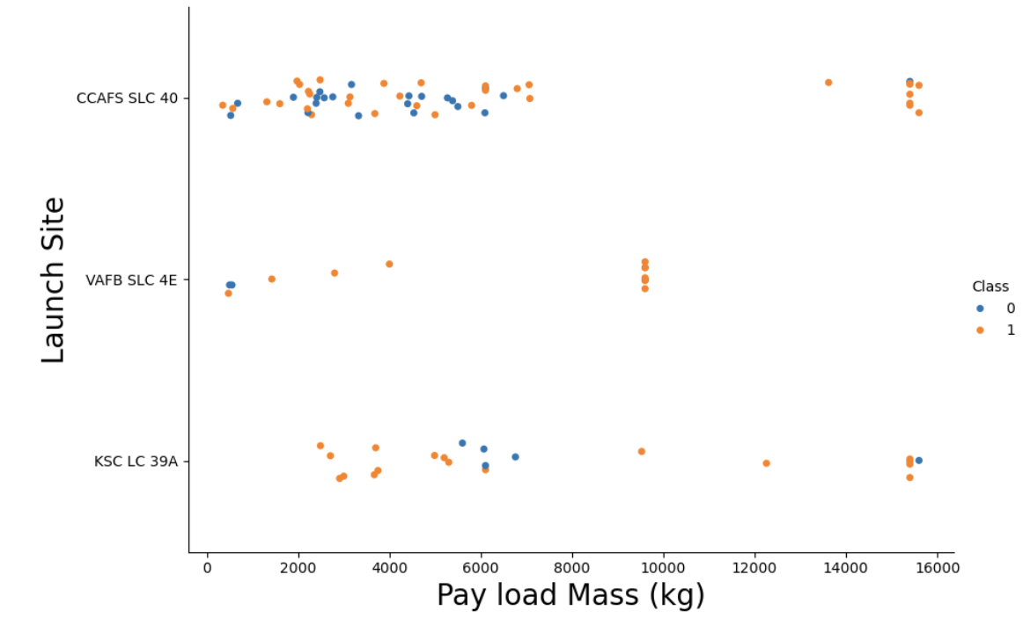
Payload vs. Launch Site
We can notice that heavier rockets have a good success rate at CCAFS whereas rockets heavier than 10000 kg have not been launched at the VAFS

Slide 19
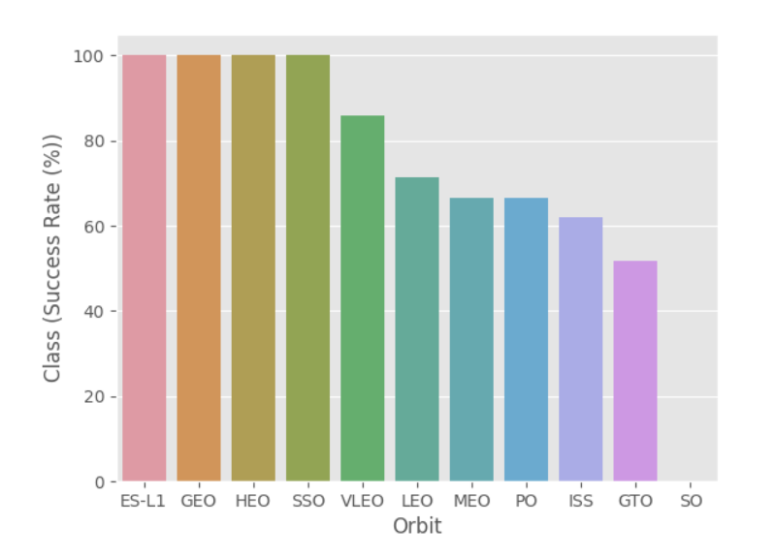
Success Rate vs. Orbit Type
Orbits ES-L1, GEO, HEO & SSO have the highest success rates at 100%, with SO orbit having the lowest success rate at ~50%.
Orbit SO has 0% success rate.

Slide 20
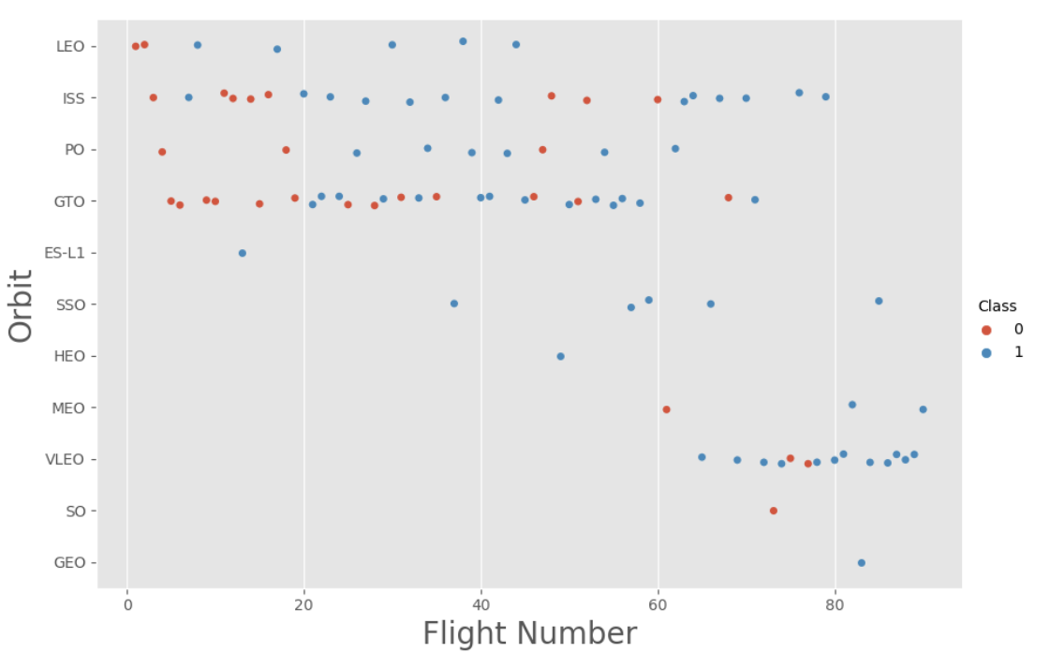
Flight Number vs. Orbit Type
You should see that in the LEO orbit the Success appears related to the number of flights; on the other hand, there seems to be no relationship between flight number when in GTO orbit.

Slide 21
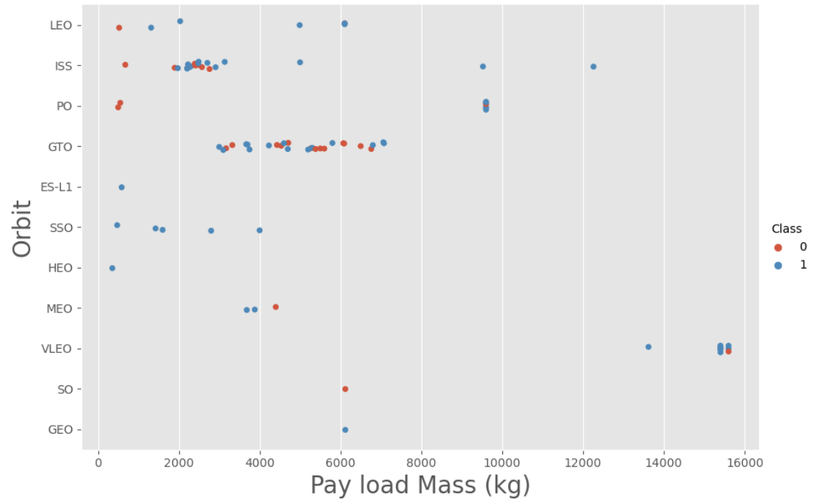
Payload vs. Orbit Type
With heavy payloads the successful
landing or positive landing rate are
more for Po, LEO and ISS.
However for GTO we cannot
distinguish this well as both
positive landing rate and negative
landing(unsuccessful mission) are
both there here.

Slide 22
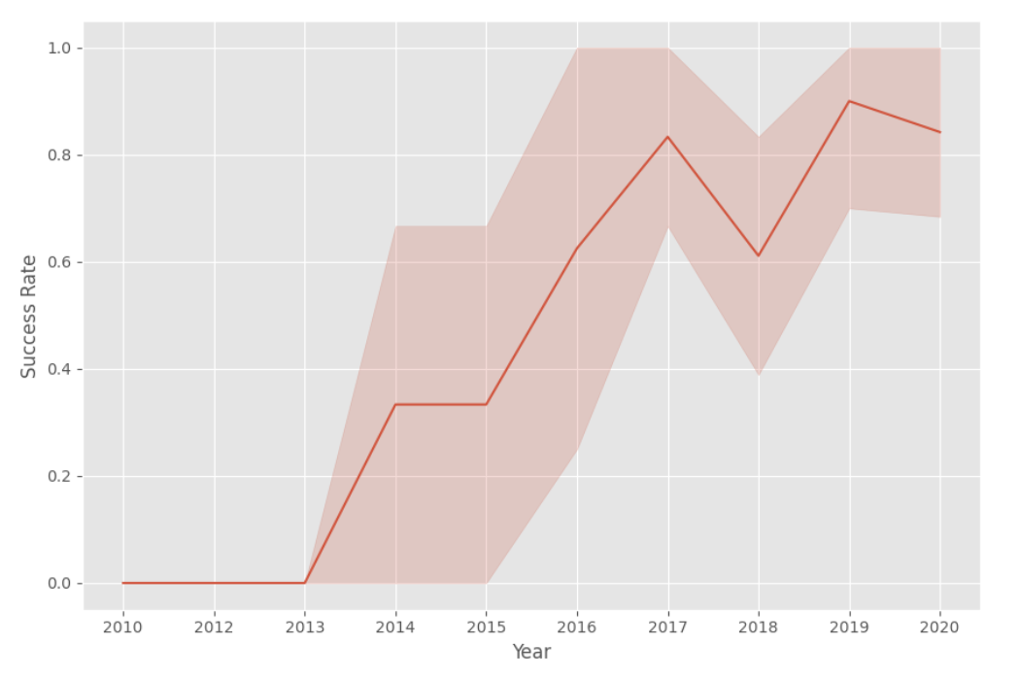
Launch Success Yearly Trend
You can observe that the success rate since 2013 kept increasing till 2020

Slide 23
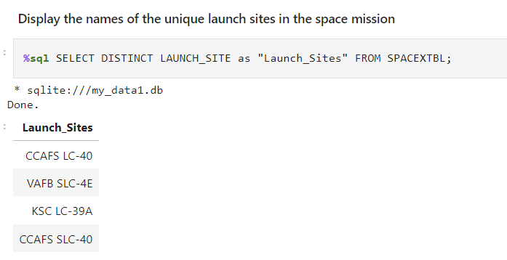
All Launch Site Names

Slide 24
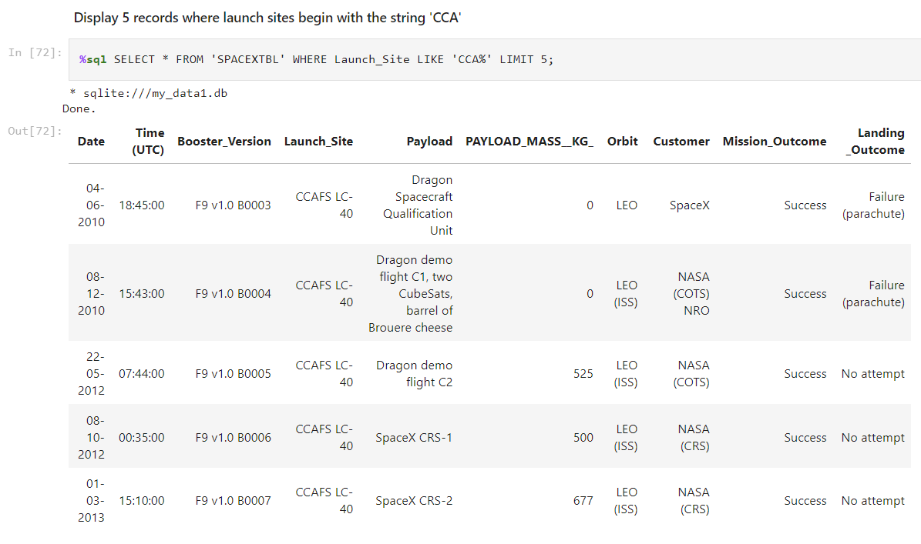
Launch Site Names Begin with 'CCA'

Slide 25
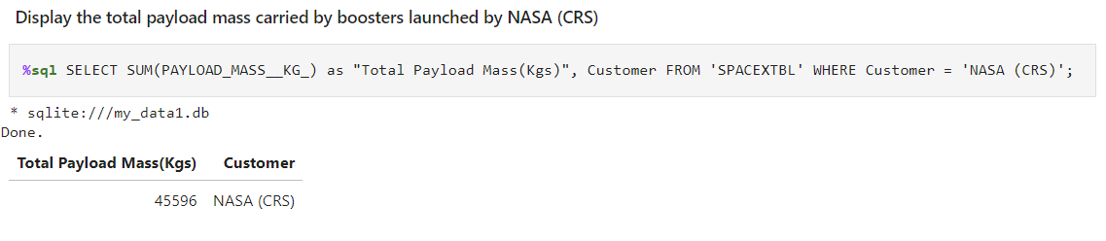
Total Payload Mass

Slide 26
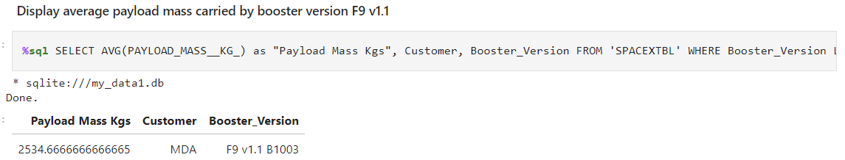
Average Payload Mass by F9 v1.1

Slide 27
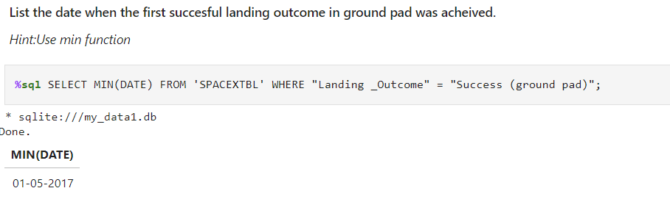
First Successful Ground Landing Date

Slide 28
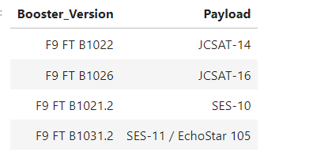
Successful Drone Ship Landing with Payload between 4000 and 6000
List the names of boosters which have successfully landed on drone ship and had payload mass greater than 4000 but less than 6000

Slide 29
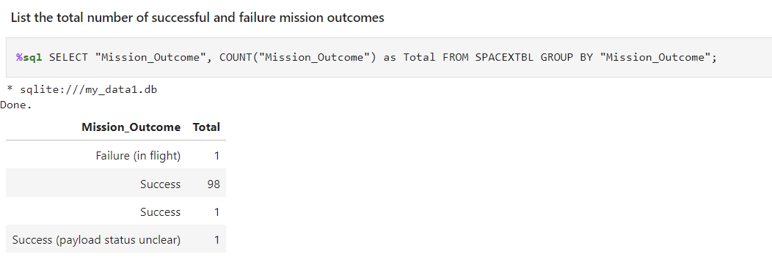
Total Number of Successful and Failure Mission Outcomes
Calculate the total number of successful and failure mission outcome

Slide 30
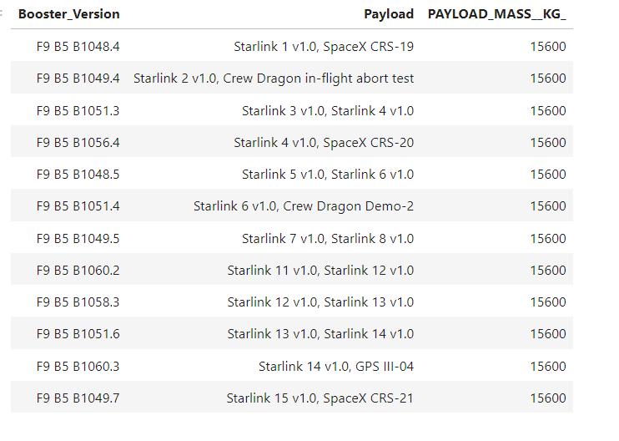
Boosters Carried Maximum Payload
List the names of the booster which have carried the maximum payload mass

Slide 31
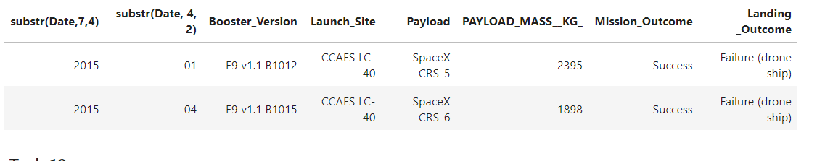
2015 Launch Records
List the failed landing_outcomes in drone ship, their booster versions, and launch site names for in year 2015

Slide 32
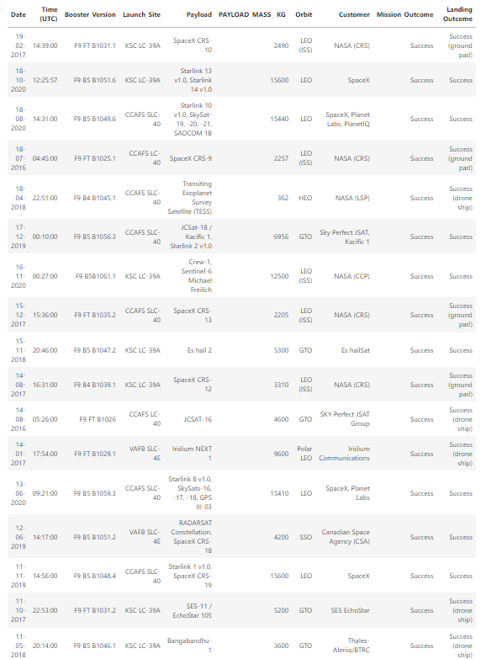
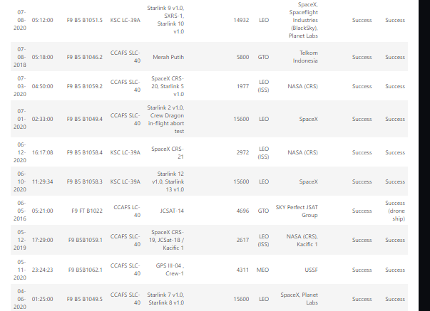
Rank Landing Outcomes Between 2010-06-04 and 2017-03-20
Rank the count of landing outcomes (such as Failure (drone ship) or Success (ground pad)) between the date 2010-06-04 and 2017-03-20, in descending order

Slide 33

Section 5

Slide 34
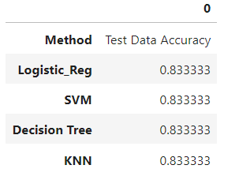
Classification Accuracy

Slide 35
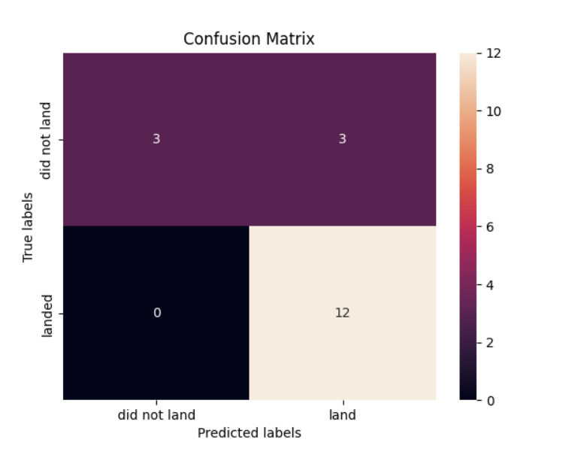
Confusion Matrix
Show the confusion matrix of the best performing model

Slide 36
Conclusions
The predictive models, including logistic regression, k-nearest neighbors, decision tree, and support vector machine, consistently achieved an accuracy of 83.3 percent in forecasting the success of Falcon 9 rocket first stage. ‘
This suggests that the chosen features exhibit meaningful patterns in relation to mission outcomes.
While this provides a reliable baseline, further exploration of additional evaluation metrics and consideration of real-world factors will enhance the robustness and applicability of the predictive models.

Slide 37


